Slide 1

Swag Labs Testing & Automation
FINAL PROJECT DOCUMENTATION | DEPI INITIATIVE

Slide 2



Introduction
Project Context
Target Application
This project is part of the Digital Egypt Pioneers Initiative (DEPI). The primary objective is to execute a comprehensive Quality Assurance cycle, encompassing both manual and automation testing strategies.
Swag Labs (saucedemo.com) serves as the testing ground. It is an educational e-commerce platform designed to simulate real-world QA scenarios, including Login, Inventory, and Checkout flows.

Slide 3
Project Scope
In Scope
Out of Scope
•
Login Functionality Validation
•
Performance Testing
•
Inventory Browsing & Filtering
•
Security Vulnerability Scanning
•
Add to Cart & Cart Management
•
Load & Stress Testing
•
Full Checkout Process
•
Penetration Testing
•
Manual Test Case Execution
•
Mobile Application Testing
•
Selenium Automation (Java)

Slide 4






Test Strategy
Methodology
Tools
Environment
Functional, UI, Negative, and Regression testing to ensure application stability and reliability across core updates.
Google Sheets for Test Management , Excel for Bug Tracking, and Postman for API checks.
Tests executed on the Production Demo environment using Google Chrome 131 for consistent rendering.

Slide 5
Manual Testing Requirements
ID | Requirement Description
REQ-01 | The system shall allow users to log in using valid credentials.
REQ-02 | The inventory page shall display all available products correctly.
REQ-03 | Users shall be able to add specific items to the shopping cart.
REQ-04 | The checkout process shall require valid user information.
REQ-05 | Users shall be able to remove items from the cart seamlessly.

Slide 6
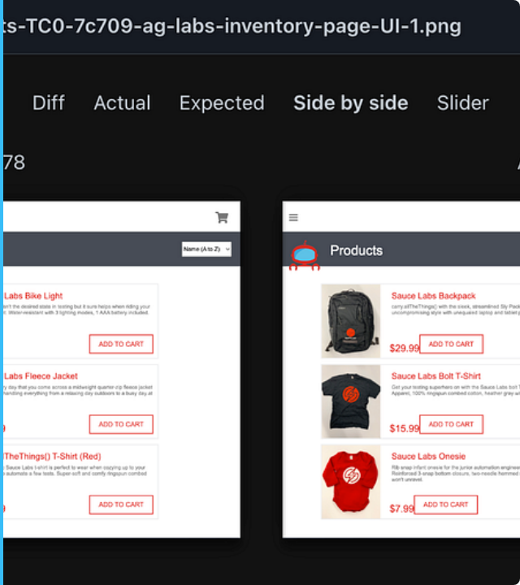
User Story: Login
US-01
"As a Standard User, I want to log in with valid credentials So that I can access the Inventory page."
Acceptance Criteria:
•
Valid credentials redirect to /inventory.html.
•
Invalid credentials display a red error message.
•
Empty username/password triggers a validation error.

Slide 7
Test Cases (Sample)
ID | Title | Steps | Expected Result
TC-LOGIN-01 | Valid Login | Enter valid user/pass & Click Login | Redirect to Inventory
TC-LOGIN-02 | Invalid Login | Enter invalid creds & Click Login | Error message displayed
TC-INV-01 | Add to Cart | Click "Add to Cart" | Cart icon count +1
TC-CHK-01 | Checkout | Fill form & Click Finish | "Complete" page appears

Slide 8


Traceability & Defects
Traceability Matrix (RTM)
Defect Report Sample
Ensuring complete test coverage by mapping Requirements to Test Cases.
ID: BUG-007
Title: Cart icon does not update for multiple items.
REQ | Story | Test Case
REQ-01 | US-01 | TC-LOGIN-01
REQ-03 | US-03 | TC-INV-01
Priority: High Severity: Medium
Actual: Cart icon stuck on "1".
Expected: Cart count shows "2".

Slide 9
Automation Strategy
Automation Scope
Framework Details
Automation focuses on critical, repetitive paths to ensure regression stability. Unstable UI elements (animations) are excluded.
Built using Selenium WebDriver with Java, implementing the Page Object Model (POM) design pattern.
•
Separation of Test Logic & Locators
•
Successful Login Flow
•
Reusability of code
•
Add Item to Cart
•
Explicit Waits for synchronization
•
End-to-End Checkout

Slide 10



Automated Scenarios
Scenario 1: Login
Scenario 2: Cart
Scenario 3: Checkout
Navigate to login, enter valid credentials, and assert redirection to the Inventory page.
Identify a specific product, click "Add to Cart", and assert the badge count updates.
Proceed to cart, fill customer details, complete order, and verify success message.

Slide 11
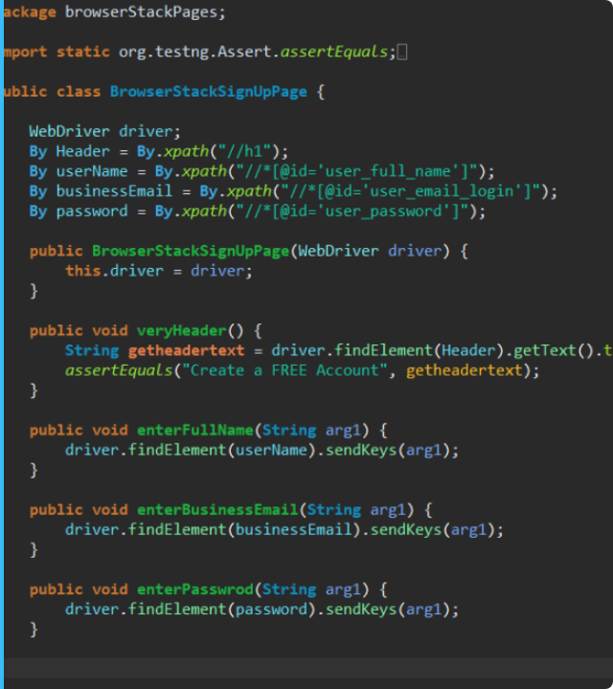
Page Object Model
The framework utilizes a modular structure to enhance maintainability and readability.
Core Classes:
LoginPage.java
Handles user authentication and validation.
ProductsPage.java
Manages inventory interaction and cart additions.
CartPage.java
Controls the checkout process and item verification.

Slide 12
Conclusion & Recommendations
Success: Core functionality of Swag Labs was validated via both Manual and Automation testing.
Stability: Automation scripts for Login, Cart, and Checkout executed without failure using the POM framework.
Recommendation 1: Implement a 'Search' functionality to improve user experience.
Recommendation 2: Improve error message clarity for better user feedback during validation failures.

Slide 13
Questions?
Project by:
Mahmoud Abdo
Reneh Raafat
Meran Ramadan
Sarah Ashraf
Mazen Azhary
Mentor: Ahmed Essam

